Slide 1
Sports as a Pathway to Social, Emotional, and Physical Health for Positive Youth Development
Kanoe Enos, MSW
Keiki Carlos
Liliʻuokalani Trust

Slide 2
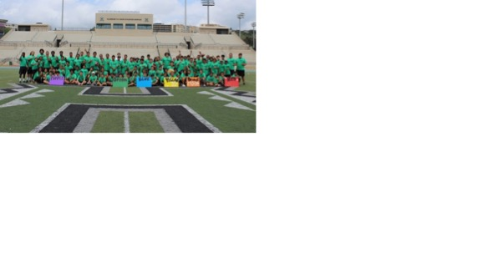
Liliʻuokalani Trust
Liliʻuokalani Trust
Sports Pathway

Slide 3
Liliʻuokalani Trust
Our marching orders
Break the cycle of poverty and research/data dives
How do we engage the most vulnerable youth?
Youth love Play and Sports

Slide 4
What is Sports Culture?
Positive force in our communities
Impact in the lives of youth, in the lives of communities
ASPEN data
Sports specialization
Less inclusive
Less centered around community
Notes:
ASPEN helped to guide us (not a confirmation bias) by giving us numbers about the monetizing of sports.

Slide 5
Sports in Traditional Native Hawaiian Times
Uhauhumu
Traditional context
As a metaphor for:
Inclusion
Strength in diversity
Uhauhumu Pōhaku
Pilot partnership with UH Athletics
What we learned through a retrospective culturally-informed youth survey (Hoʻāmana survey)
Notes:
Based on what we learned, Uhauhumu Pōhaku was our piloted response, informed by the data.
What is Uhauhumu?
No matter the exclusion they felt, in a safe place, if the tone is set by mentors, kamalii will take risks, get back up, put self out there. They would re- or ignite the love for play (put down their barriers to play). In order to break the cycle of poverty, it is not theorugh creating 5 star athletes. We need to create community….. Regardless of physical, cognitive, sexual identity, SES...if want to break COP, Play is an integral part of that.

Slide 6
So what’s next?
Expand Uhauhumu Pōhaku
Sports sampling into football, softball, and ocean sports
Formal partnership with ASPEN Institute to examine the culture of sports in the communities in which LT works across the state
Inspiring scalable work
Coaches, players, administrators, ʻohana

Slide 7
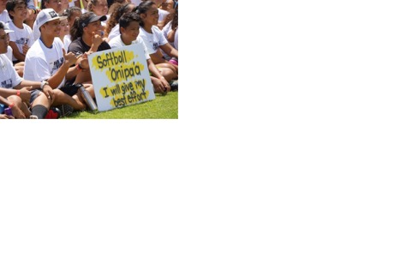
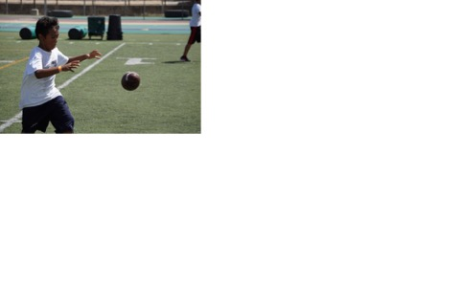
Implications for Social Work
Serving the most vulnerable in society
Client-centered
Experiential
Inclusion
Equity and Social Justice
Engagement

Slide 8
Uhauhumu Pōhaku 2017
Video- UhaUHumu Pōhaku UH Football Field Day

