Slide 1
Expect [ r e s p e c t ]™ : A creative approach to sexual violence prevention education
Jennifer Fonseca, MPH - The Sex Abuse Treatment Center
David Nisthal, MSW - The Sex Abuse Treatment Center
Eric Johnson - Honolulu Theatre for Youth
CREATING A HEALTHIER HAWAIʻI

Slide 2
Care for
Survivors
Medical-Forensic Exams
Educating the Community
Advocating for Legal Reform
CREATING A HEALTHIER HAWAIʻI

Slide 3
Defining Sexual Violence
The Center for Disease Control (CDC) defines sexual violence as:
a sexual act committed against someone without that person’s freely given consent
Basile KC, Smith SG, Breiding MJ, Black MC, Mahendra RR. Sexual Violence Surveillance: Uniform Definitions and Recommended Data Elements, Version 2.0
CREATING A HEALTHIER HAWAIʻI

Slide 4
4￼
The Spectrum of Sexual Violence
Unwanted
Sexual
Contact
Noncontact
Unwanted
Sexual
Experiences
Physically
Forced
Penetration
Alcohol/Drug Facilitated Penetration
Non-physically
Forced
Penetration
Each form of sexual violence can contain an element of
Force
Coercion
Misuse of power
Intimidation
Exploitation of vulnerability
Grooming tactics
Degradation of character
Fraud
Basile KC, Smith SG, Breiding MJ, Black MC, Mahendra RR. Sexual Violence Surveillance: Uniform Definitions and Recommended Data Elements, Version 2.0
CREATING A HEALTHIER HAWAIʻI

Slide 5
Prevalence of Sexual Violence
1 in 5
Women
1 in 15 Men
Basile KC, Smith SG, Breiding MJ, Black MC, Mahendra RR. Sexual Violence Surveillance: Uniform Definitions and Recommended Data Elements, Version 2.0
CREATING A HEALTHIER HAWAIʻI

Slide 6
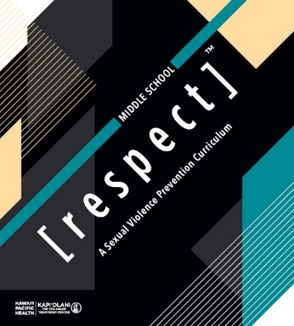
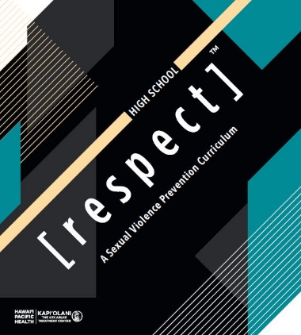
Education is Key
Sexual Violence Prevention Curricula & Training Program
Age appropriate materials and activities
Aligns with Hawaii Content Performance Standards III
Evidence-informed curricula
Tools for educators
Over 900 educators trained state-wide
Notes:
Confirm with Jenn about who can trained in curricula
Only teachers, counselors of DOH project?
Any teacher, counselor of any DOE school?

Slide 7
Community Partnership
Theatrical performances provided through the partnership of the SATC and HTY include:
[ r e s p e c t ]™ 2.0
A dynamic, and interactive performance for high school-aged students that combines theater with technology to discuss sexual violence prevention in an age of social media.
Expect [ r e s p e c t ]™
Short vignettes designed for middle school-aged students that incorporates a theatrical performance and discussion focusing on the importance of respecting boundaries and creating a safer environment for everyone.
Rally for [ r e s p e c t ]™
The Rally brings together artists and high school students to engage in creative workshops designed to convey [ r e s p e c t ]™. Artists educate youth using music, theater, culture, visual art, dance, and spoken word to express their vision for respectful relationships and safe communities, free of sexual violence.
CREATING A HEALTHIER HAWAIʻI

Slide 8
CREATING A HEALTHIER HAWAIʻI

Slide 9
Thank you!
To request an educational presentation, please contact:
The Sex Abuse Treatment Center at 808.535.7600
CREATING A HEALTHIER HAWAIʻI

